Slide 1
MultiBERTSumm: Extractive Multi-Document Summarization Using BERT
CSCI 8873 Honour Thesis Presentation
Supervisor: Evangelos Milios
Junqiao Qu 2022, Apr, 7

Slide 2
MOTIVATION
Redundancy in the Information
Useful Information Needs to be Extracted
Multi-document summarization is less explored

Slide 3
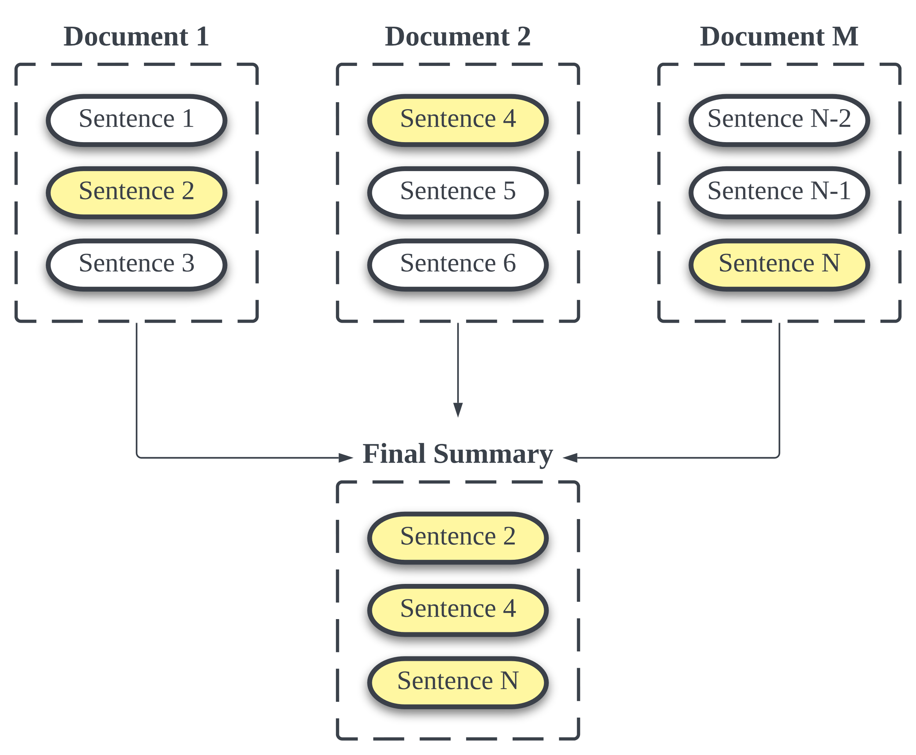
Problem Definition
Extractive Summarization
Input : A cluster containing multiple documents
Task: Select m sentences from N sentences in documents, try to make the final summary coherent and informative
Output: A summary contains m sentences

Slide 4
Related Work
Clustering based extractive summarization
Graph based extractive summarization
Deep learning based extractive summarization

Slide 5
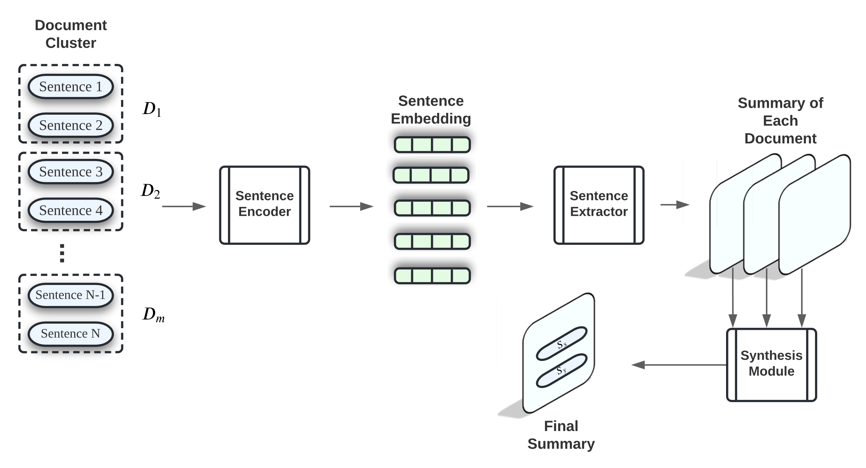
Proposed Model
Generate a summary for each document. Then synthesize each summary into a final summary that could represent the cluster
Sentence Encoder: generate sentence embedding
Sentence Extractor: classify whether a sentence should be extracted
Synthesis Module: find commonalities between each summary, generate final summary

Slide 6
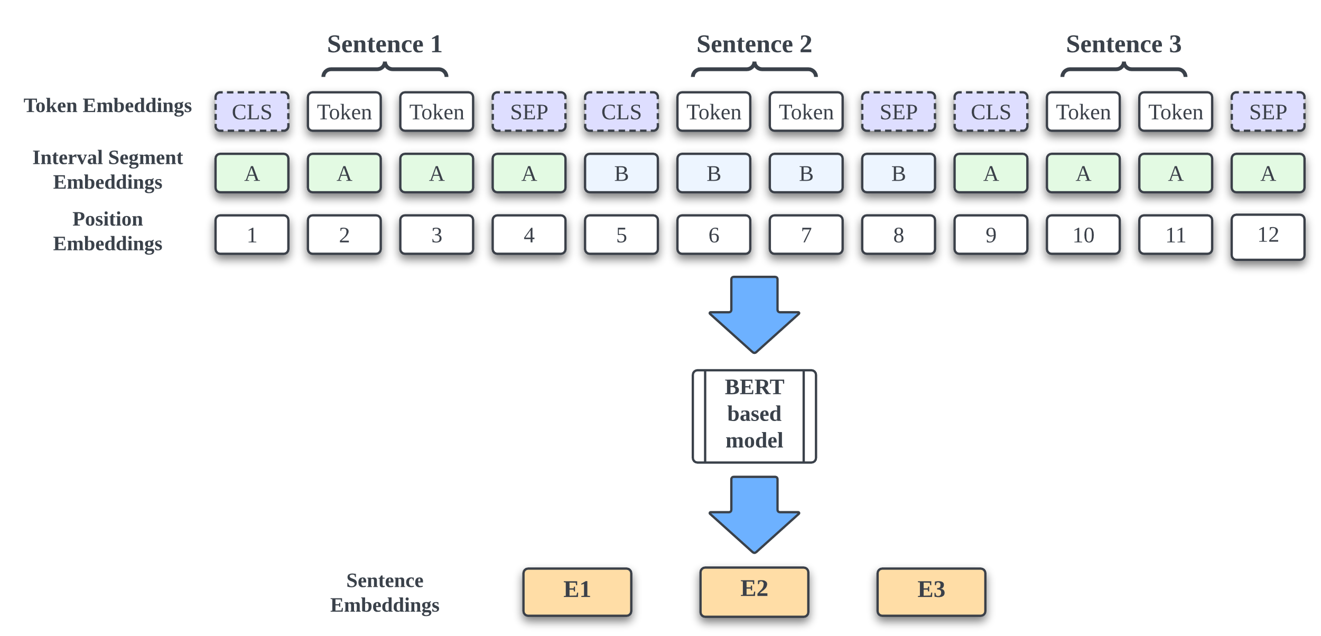
Sentence Encoder
A pre-trained BERT based model, which could generate embeddings for each sentence
Input: tokenized sentence, with padding and truncation
Output: embedding vector of sentences
RoBERTa, DistilBERT, BERT

Slide 7
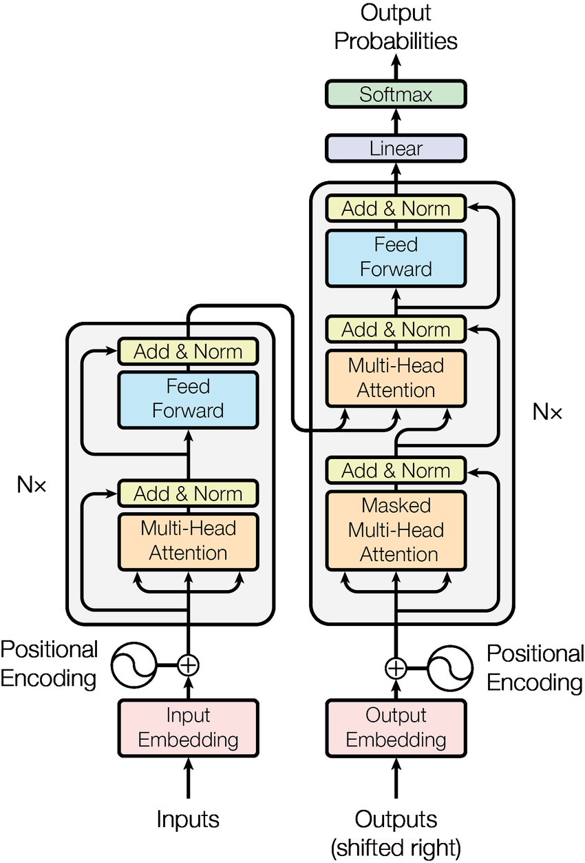
Sentence Extractor
2-layer Transformer
Input: Sentence Embeddings
Positional Encoding enables the model to find inter-sentence relationship in the document.
Output: The probability of a sentence to be included in the candidate summary
Diagram from: Vaswani, Ashish, et al. "Attention is all you need." Advances in neural information processing systems 30 (2017).

Slide 8
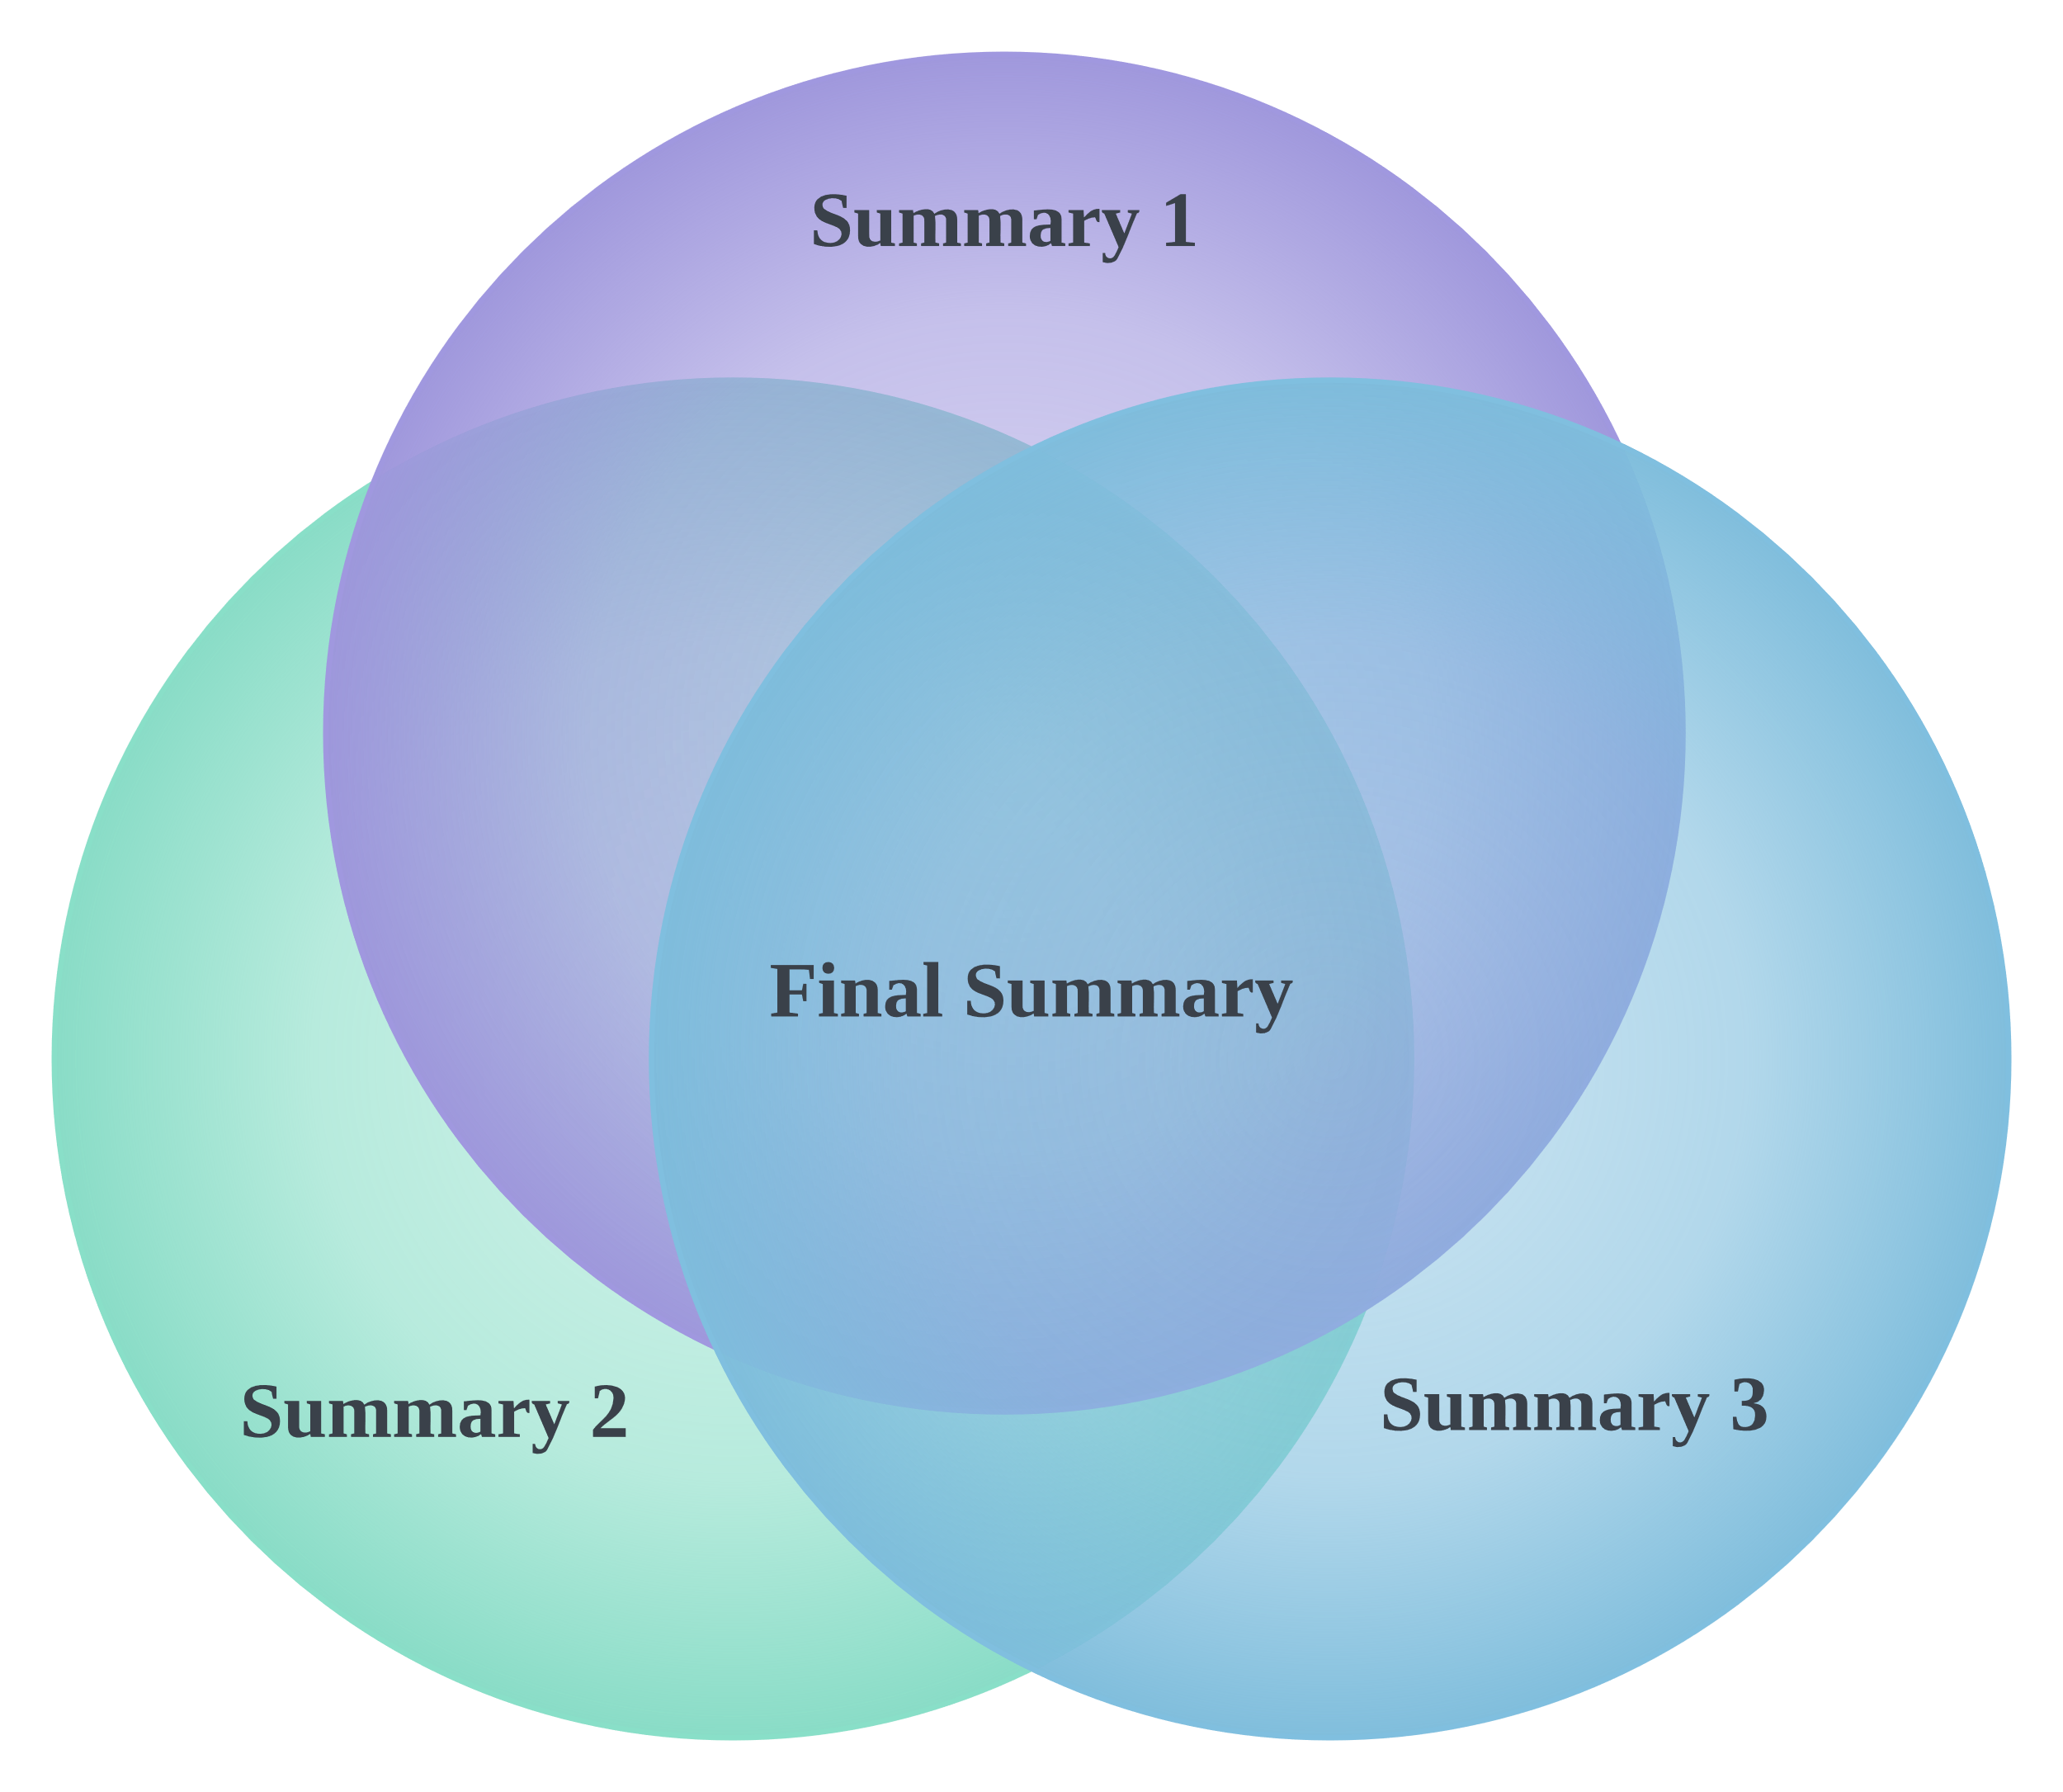
Synthesis Module
Find the commonalities between each summary of single document
Synthesize them into a final summary of multi-document clusters
Assumption: Information that occurs in many of the input summaries is likely important and worth selecting in a summary

Slide 9
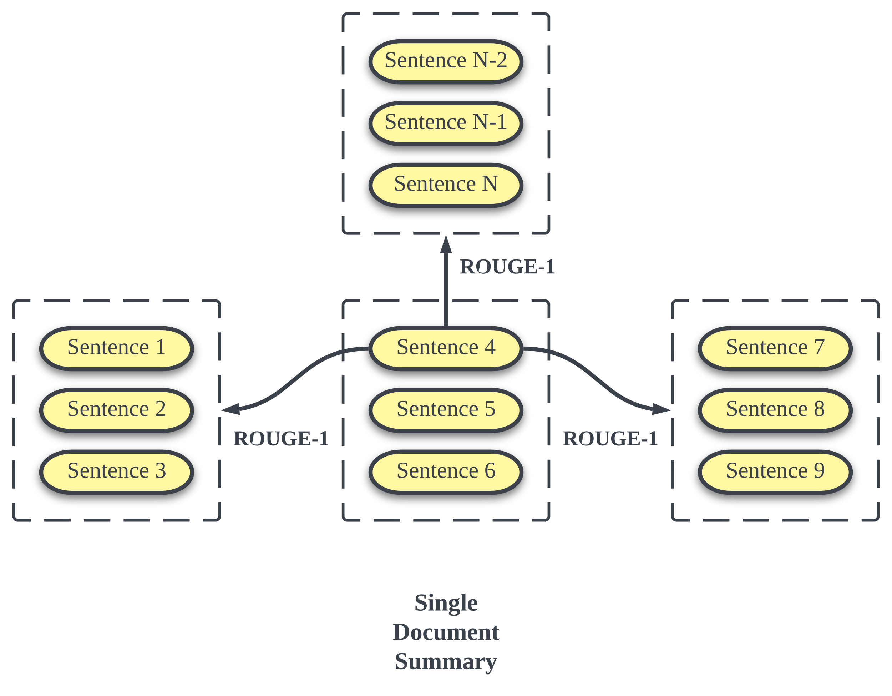
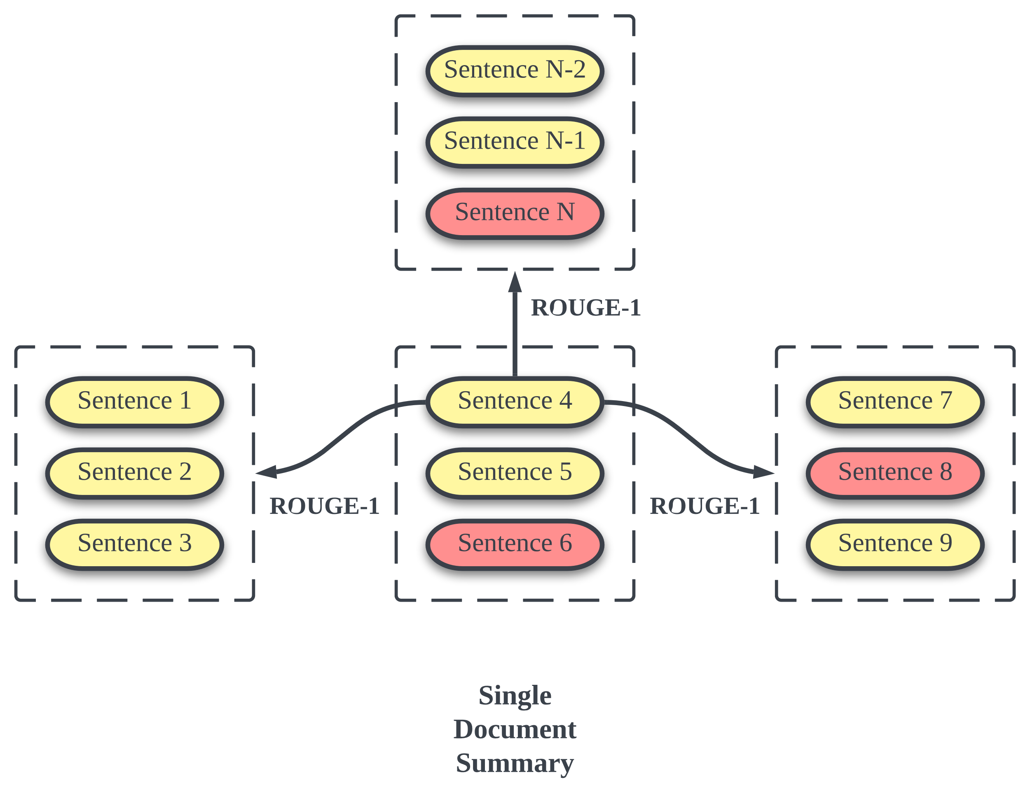
Synthesis Module
Assess commonalities by n-gram similarity.
Aggregating ROUGE score between current sentence and the other document summary
Select n sentences of the highest score

Slide 10
Dataset
CNN/DailyMail
Contains just over 300k unique news articles as written by journalists, each with a human-written summary.
Topic of articles is a mix of politics, sports, and entertainment
Fine-tuning and training (large corpus)
Example: {'id': '0054d', 'article': '(CNN) -- An American woman died aboard a cruise ship that docked at Rio de Janeiro … ' 'highlights': 'The elderly woman suffered from diabetes and hypertension.'}

Slide 11
Dataset
DUC 2004
Dataset contains 50 clusters and each cluster has 10 articles and 4 reference summaries
Each document describes the same topic and has a medium length
Evaluation dataset for our system (relatively small)

Slide 12
Evaluation Metrics
Baseline: Lead 3
Evaluation Score: ROUGE-1, ROUGE-2, ROUGE-L
Gold Label: Extract Label Generated by Oracle Algorithm

Slide 13
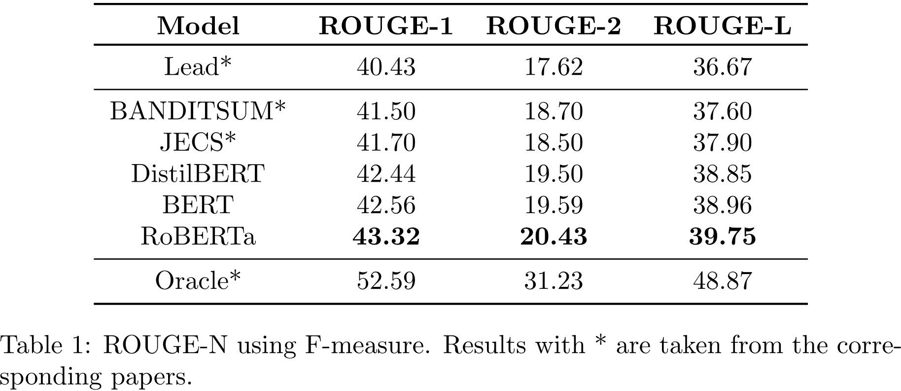
Fine-tune Result CNN/DailyMail
13

Slide 14
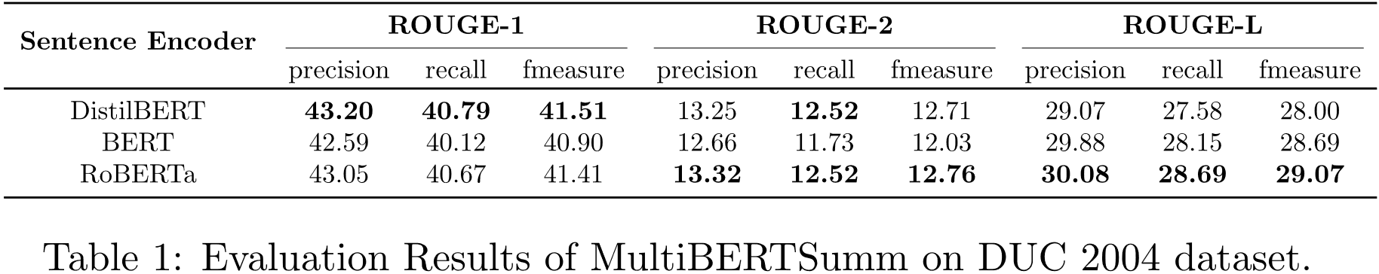
Evaluation on DUC2004
14

Slide 15
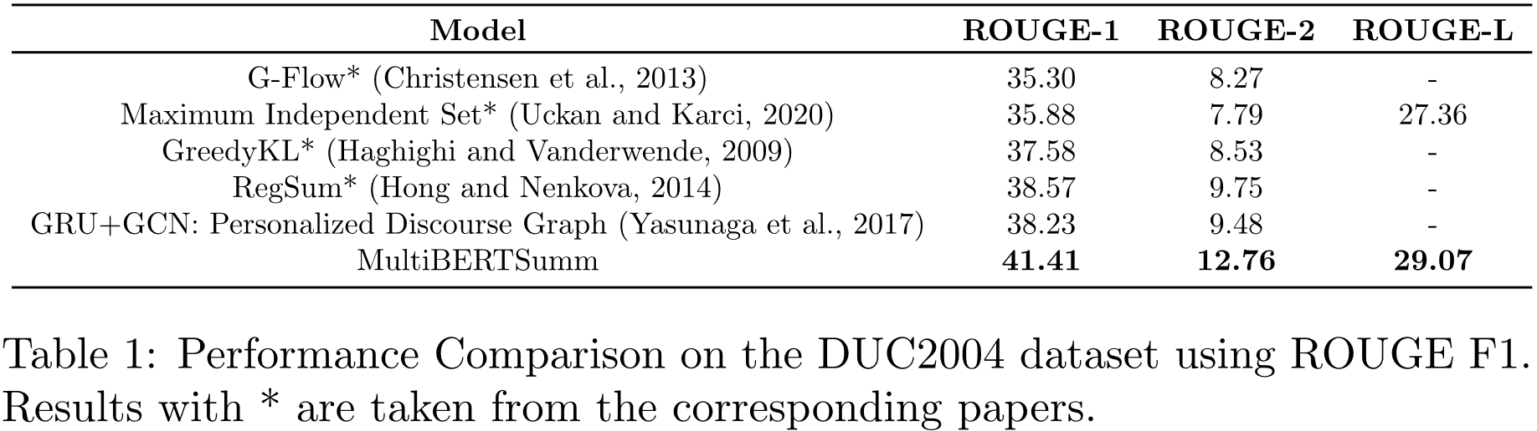
Comparison Related Method
15

Slide 16
Sample Final Summary
Issue: Less relevant phrases in the sentence
[1]Pinochet was arrested in London on Oct. 16 at the instigation of Spanish magistrate Baltasar Garzon who is seeking to extradite the former dictator on charges of genocide , terrorism, and torture.
[2] As his lawyers in London tried to quash a Spanish arrest warrant for Gen. Augusto Pinochet , the former Chilean dictator , efforts began in Geneva and Paris to have him extradited.
[3]In London, where Pinochet has been under arrest in a clinic for the last 10 days , a phalanx of British lawyers argued before the High Court of Justice that the arrest order sent from Spain was illegal because the general, 82, is not a Spanish citizen.
Compare with reference summaries, ROUGE-1=0.53, ROUGE-2=15.38, ROUGE-L=0.33

Slide 17
Conclusion
Proposed a new multi-document summarization system using BERT based model
Could generate a coherent summary that contains important and comprehensive information of the document cluster
System achieves a competitive performance than the baseline methods

Slide 18
Future Work
A potential compression module could be added
Experiment with more choices for sentence encoder
Evaluate our system on more datasets to examine its robustness

Slide 19

Thank You!

